Slide 1
Diversification and explanations in recommender systems
Mikko Eerola

Slide 2
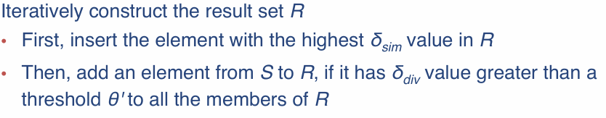
Diversification method: Motley with F-score
Motley aggregation:
New method: Motley with F-score
Add element from S to R, if it improves F(q,R) more than threshold theta.
Using embedded genre vectors and cosine similarity with sim and div

Slide 3
Pros and cons
Direct control over F-score:
Given a target F-score the variable theta can be selected to achieve the target, if possible, from the candidate set
When the candidate set is sorted gives ’same’ results than Motley
Candidate set can be left random, F-score includes similarity -> Faster

Slide 4
Counterfactual explanations
Greedy grow with diversity clustering rebuild

Slide 5
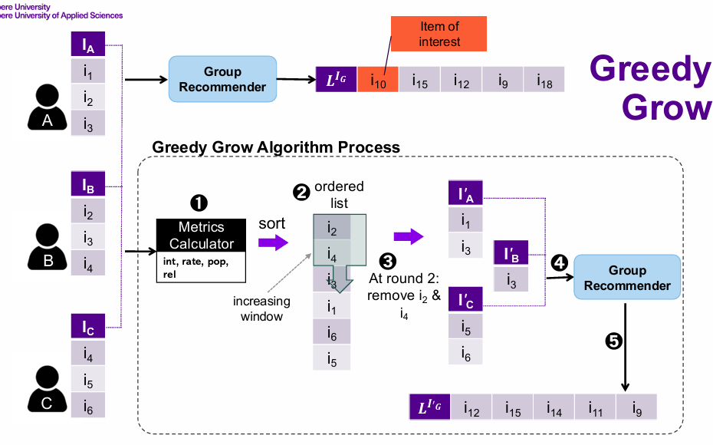
Explanations with Greedy Grow
Source: DATA.ML.360-2025-2026 lecture slides, Stefanidis and Stratigi

Slide 6
New method: Diversity clustering rebuild
Greedy Grow out puts an explanation list l_t, where t represents the target movie.
Using the list l_t and the groups sub user-movie-matrix, divide l_t into clusters. Clustering is done by k-means algorithm and rating behaviour vectors = the groups ratings to given movie.
Number of clusters is given by k = floor(log(len(expls)) (not optimal?)
Select a representative from each cluster using same metrics than in Greedy Grow sorting.

Slide 7
Pros, cons and open questions
Low cost
Short explanations
How to select k for k-means algorithm?
How to select the representative from each cluster? Influence metrics? -> more costly
Clustering on some other metrics?

